Slide 1
Gov2k2 Final Review Jeopardy!
Put a (Beta)
Hat On it
I Do it All for
The (L)OLS
Assuming the Worst
Positive
Interactions
Normally, I’m
Pretty
Confident
$200
$200
$200
$200
$200
$400
$400
$400
$400
$400
$600
$600
$600
$600
$600
$800
$800
$800
$800
$800
☠ Final Jeopardy ☠

Slide 2
Put a (Beta) Hat on It - $200
Clue
True or false:
You can eliminate omitted variable bias (OVB) by adding more observations to a regression model.
False!
OVB makes the OLS estimator both biased and inconsistent. Therefore reducing the variance of the estimator by increasing n does not eliminate the bias asymptotically (the OLS estimator does not converge on the true value).

Slide 3
Put a (Beta) Hat on It - $200
Back
True or false:
You can eliminate omitted variable bias (OVB) by adding more observations to a regression model.
The answer is implicit in the name!

Slide 4
Put a (Beta) Hat on It - $400
Clue
Suppose we omit a variable from a regression model. That variable is negatively correlated with our independent variable X and negatively correlated with the outcome Y.
Will our OLS estimator tend to over-estimate, under-estimate, or correctly estimate the true coefficient on X?
Over-estimate (or be upwardly biased). By the omitted variable bias formula the bias is β₂ ᐧ Cov(Z, X) / Var(X). The former is negative when Y and Z are negatively correlated and the latter is also negative since Var(X) is strictly positive. Therefore the bias is positive.
Notes:
clue: give Covariance formula

Slide 5
Put a (Beta) Hat on It - $400
Back
Suppose we omit a variable from a regression model. That variable is negatively correlated with our independent variable X and negatively correlated with the outcome Y.
Will our OLS estimator tend to over-estimate, under-estimate, or correctly estimate the true coefficient on X?
The OVB formula is β₂ ᐧ Cov(Z, X) / Var(X)

Slide 6
Put a (Beta) Hat on It - $600
Clue
Assume the following population model:
Y = β₀ + β₁X + u
Your friend proposes the following estimator for β_{1:}
β_{1*} = β_{1OLS} / (1 + λ)
Where λ > 0 is a positive constant and β_{1OLS} is the usual OLS estimator (X’X)⁻¹Xy.
What’s the direction of the bias of this estimator β_{1*}?
Does β_{1*} have higher or lower variance than β_{1OLS}?
The bias tends toward zero since 1/(1 + λ) < 1, which attenuates the OLS estimator toward zero. Since we know the OLS estimator is unbiased, this alternative estimator is biased.
The variance is lower than β_{1OLS} :
Var(β_{1OLS}/(1 + λ)) = 1/(1 + λ)² ᐧ Var(β_{1OLS})
Var(β_{1OLS}) is strictly positive and 1/(1 + λ)² is strictly less than 1.

Slide 7
Put a (Beta) Hat on It - $600
Back
Assume the following population model:
Y = β₀ + β₁X + u
Your friend proposes the following estimator for β_{1:}
β_{1*} = β_{1OLS} / (1 + λ)
Where λ > 0 is a positive constant and β_{1OLS} is the usual OLS estimator (X’X)⁻¹Xy.
What’s the direction of the bias of this estimator β_{1*}? E[β_{1OLS} / (1 + λ)]?
Does β_{1*} have higher or lower variance than β_{1OLS}? V[β_{1OLS} / (1 + λ)]

Slide 8
Put a (Beta) Hat on It - $800
If your OLS estimator is the Best Linear Unbiased Estimator, which of the following are true:
1. OLS has the lowest possible variance of any estimator
2. In small samples, test statistics for coefficient estimates will have t-distributions
3. Standard error estimates are unbiased and consistent for the true standard error
4. There exists no other unbiased estimator of the coefficients that has lower variance than OLS
5. All of the above!
Just 4!
Recall from the hierarchy of assumptions that BLUE refers to the lowest variance among unbiased estimators. We can always trivially get lower variance by picking a biased estimator like β₁* = 5, which has a variance of 0.

Slide 9
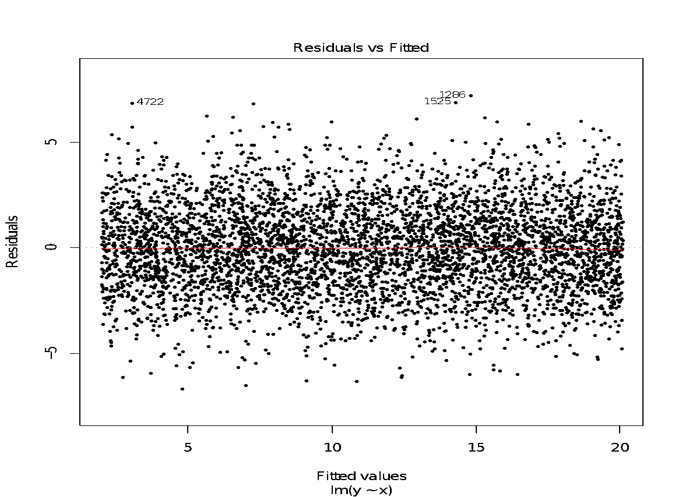
I Do it all for The (L)OLS- $200
Look at the following fitted values v. residuals plot. Does this plot suggest any evidence of heteroskedasticity or non-linearity?
Neither!
This plot presents evidence of neither non-linearity nor heteroskedasticity. The LOESS curve through these points is essentially a straight line and there are roughly even numbers of residuals above and below the horizontal line at any given fitted value, so we don't see any visual evidence of nonlinearity. On average, the residual distances from the horizontal line stay constant as we travel up or down along our axis of fitted values, suggesting that there is no meaningful evidence of heteroskedasticity here.

Slide 10
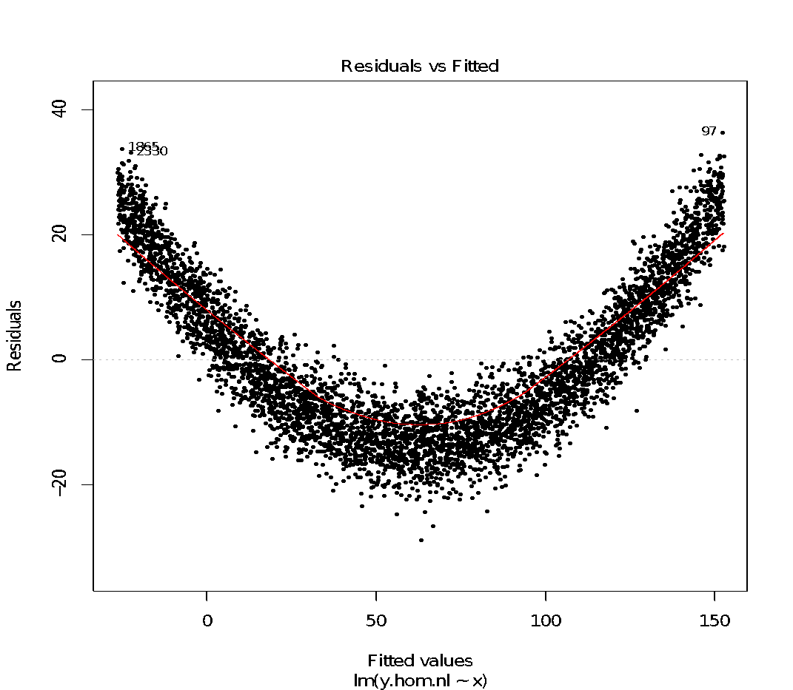
I Do it all for The (L)OLS - $400
Take a look at the fitted values vs. residuals plot below. Does this plot suggest that there may be evidence of heteroskedasticity in your regression model?
No!
While this plot clearly suggests non-linearity (the LOESS curve through these points are in the shape of a parabola), the the average spread of the residuals around the LOESS curve through these points doesn't actually change much as we go up or down along our axis of fitted values.

Slide 11
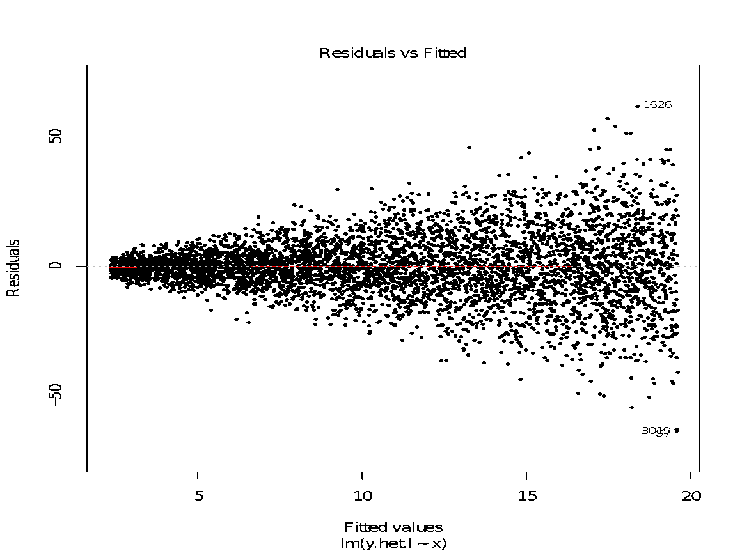
I Do it all for The (L)OLS - $600
Take a look at the fitted values vs. residuals plot below. Does this plot suggest that there may be evidence of heteroskedasticity in your regression model?
Yes!
Here, the average spread of the residuals from the horizontal line through 0 is getting larger with larger fitted values. That suggests non-constant error variance.

Slide 12
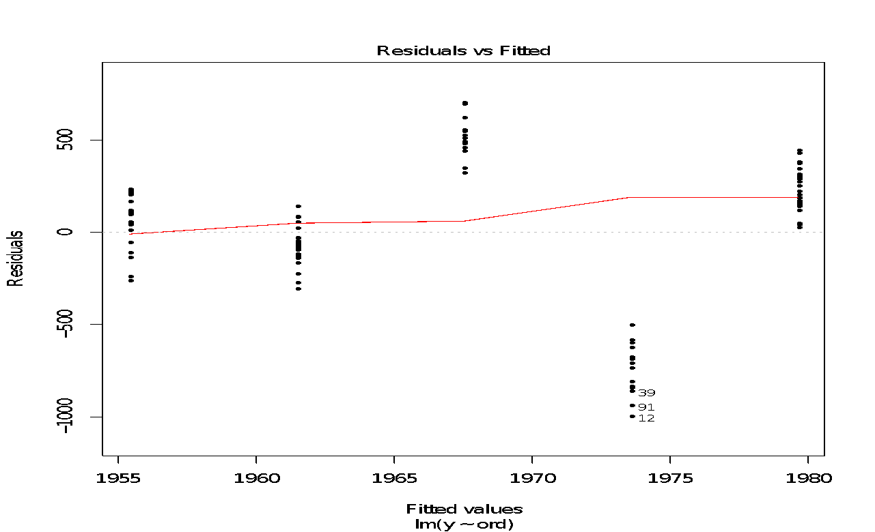
I Do it all for The (L)OLS - $800
Suppose you have an ordinal covariate X that takes on 5 different values for 5 different years, and a continuous outcome variable, Y.
In an attempt to estimate E[Y|X], you run the regression lm(Y ~ X) and decide to do some diagnostics. R returns the fitted values vs. residual plot below for your model. List three issues here and how might you fix each one?
(1) Non-linearity, (2) heteroskedasticity, (3) treating ordinal variable as continuous. Fix (1) and (3) by turning X into n – 1 binary dummy variables, e.g. lm(Y ~ as.factor(X)). Fix (2) with HC SEs with lmtest and sandwich.
Clue

Slide 13
I Do it all for The (L)OLS - $800
Suppose you have an ordinal covariate X that takes on 5 different values for 5 different years, and a continuous outcome variable, Y.
In an attempt to estimate E[Y|X], you run the regression lm(Y ~ X) and decide to do some diagnostics. R returns the fitted values vs. residual plot below for your model. List three issues here and how might you fix each one?
With ordinal variables, you usually have to do an extra step before running lm()!
Back
Notes:
clue: lm() can sometimes get confused when you pass in an ordinal variable

Slide 14
Assuming the Worst - $200
Suppose you collected an i.i.d. sample for two variables: a continuous outcome variable, Y, and a binary covariate, X.
1. Is regressing Y on X a valid way to estimates E[Y | X = 1] – E[Y | X = 0]?
2. What two additional assumptions do you need for OLS to be unbiased?
3. What are the interpretations of β₀ and β₁ in a regression model for this data?
1. Yes, you can use OLS to calculate E[Y | X = 1] – E[Y | X = 0]
2. Recalling hierarchy of assumptions, we (1) regularity, meaning variation in X and (2) need E[u|X]=0, meaning zero conditional mean (i.e. no confounders of X and Y).
3. β₀= E[Y | X = 0], so our intercept is the conditional mean of Y when X = 0. β₁= E[Y | X = 1] -E[Y | X = 0], so our slope is the average difference in Y between the X = 1 and X = 0 groups.

Slide 15
Assuming the Worst - $400
Suppose you are trying to estimate a model of the following form using OLS:
Y = β₀ + β₁X + β₂Z + u
where X, Z, and Y are all continuous variables. You have 1,000 observations in your sample data. Which of the following assumptions have to hold in order for OLS to be B.L.U.E.?
1. Linearity
2. Random (i.i.d.) sample
3. Variation in X
4. E[u] = 0
5. Homoskedasticity
6. u | X ~ N(0, σ_{u}²)
We need assumptions 1-5
We need to make the conditionally normal errors assumption (6) when we are using OLS to do inference with small samples. We rely on the CLT to get normally distributed errors in large samples.

Slide 16
Assuming the Worst - $600
Which of the following population regression models represent a violation of the linearity assumption:
1. Y = β₀ + β₁X + β₂X² + u
2. Y = β₀ + β₁X + β₂log(X) + β₃X³ + β₄Z⁴ + β₅(1/Z) + u
3. Y = β₀ + β₁X + β₂Z + β₃X ᐧZ + u (X, Y, Z are binary)
4. Y = β₀ + β₁X + exp(β₂Z) + u (X is continuous, Y is binary)
5. Y = 1/(β₀ + β₁X) + β₂Z + u
Just models 4 and 5.
Models can be non-linear in variables, but not in parameters.

Slide 17


Assuming the Worst - $800
Suppose you collected a data set that contains two variables: a continuous outcome variable, Y, and a binary covariate, X. You're interested in E[Y | X = 1] - E[Y | X = 0], and you decide to calculate this quanitity of interest in two ways.
First, you calculate E[Y | X = 1] - E[Y | X = 0] nonparametrically.
Then, you run lm() and interpret β₁ as your difference in means.
Then you calculate confidence intervals for each of your difference in means estimators. But you get different values for the confidence intervals! Why might this happen?
lm() SEs assumes homoskedasticity, the diff-in-means SE we used probably doesn’t!
when X is discrete, we say that: “the above SE_{diff} uses unpooled variance, this SE_{OLS} uses pooled variance” (note, as you did in a pset, you can
assume a pooled variance for SE_{diff} also)
Clue
Notes:
clue: standard error for first you estimated with Gerber Green data in pset X; second SE you estimated in most recent pset

Slide 18
Assuming the Worst - $800
Suppose you collected a data set that contains two variables: a continuous outcome variable, Y, and a binary covariate, X. You're interested in E[Y | X = 1] - E[Y | X = 0], and you decide to calculate this quanitity of interest in two ways.
First, you calculate E[Y | X = 1] - E[Y | X = 0] nonparametrically.
Then, you run lm() and interpret β₁ as your difference in means.
Then you calculate confidence intervals for each of your difference in means estimators. But you get different values for the confidence intervals! Why might this happen?
Pset 6 Q4: you derived a standard error for a difference-in-means with the Gerber & Green data,
Pset 10 Q1: you derived a standard error for an OLS coefficient
… in what way were they different?
Back
Notes:
clue: standard error for first you estimated with Gerber Green data in pset X; second SE you estimated in most recent pset

Slide 19
Positive Interactions - $200
Suppose you estimate the following regression model:
Y = β₀ + β₁X + β₂Z + β₃X ᐧ Z + u
What's the expected marginal effect of a unit change in X conditional on Z?
β₁ + β₃Z

Slide 20
Positive Interactions - $400
Suppose you estimate the following regression model:
Y = β₀ + β₁X + β₂XᐧZ + u
Where Y is a continuous outcome variable, Z is a binary variable, and X is a continuous variable.
What assumption are you implicitly making about the relationship between X, Z, Y?
What are the implications of that assumption?
The implicit assumption here is that the coefficient on your lower-order term, which might be β₃Z, is zero.
This suggests that you think there is no difference between the Z = 0 and Z = 1 group when X is zero.
While that might be reasonable under some circumstances, you typically don't know enough to justify this assumption in practice. The implication is that your slope estimates for X at each level of Z will be distorted. Can conduct an F Test (see slide 21).
Clue
Notes:
clue: you’re assuming that something is zero

Slide 21
Positive Interactions - $400
Suppose you estimate the following regression model:
Y = β₀ + β₁X + β₂XᐧZ + u
Where Y is a continuous outcome variable, Z is a binary variable, and X is a continuous variable.
What assumption are you implicitly making about the relationship between X, Z, Y?
What are the implications of that assumption?
Hint: you’re assuming something is zero in the population regression.
Back
Notes:
clue: you’re assuming that something is zero

Slide 22
Positive Interactions - $600
Suppose you estimate the following regression model:
Y = β₀ + β₁X + β₂Z + β₃XᐧZ + u
Where X, Y, and Z are all continuous variables. Suppose
Y is wage income in USD,
X is years of work experience and
Z is # of merit-based promotions received while in workforce
What is the substantive interpretation of β₃?
β₃ tells us the change in the effect that years of work experience has on wage income given a one unit change in the number of promotions an individual has received in the workforce.
We might use a model like this if we think an individual's wage income depends on some interaction between their work experience (seniority) and some proxy for their productivity (promotions).

Slide 23
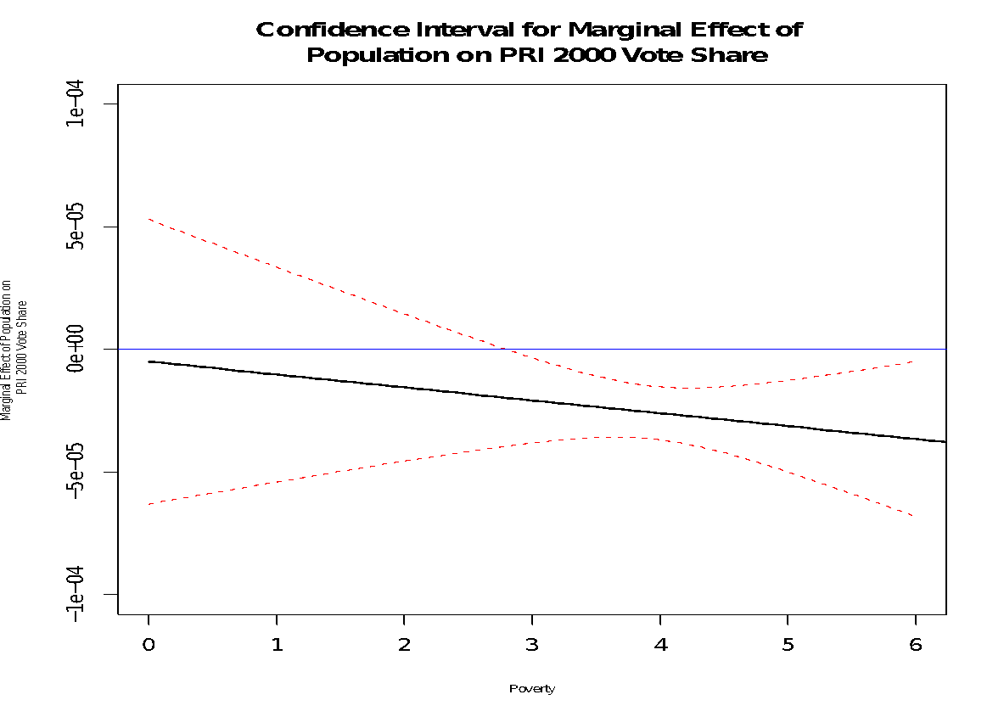
Positive Interactions - $800
Suppose you use the following interactive model to estimate the PRI (Mexico's Partido Revolucionario Institucional)'s vote share as a function of poverty and population:
Vote share = β₀ + β₁poverty + β₂population + β₃poverty ᐧ population + u
The following is a 95% CI plot of the marginal effect of population on the PRI's vote share. What function is being plotted here? What does this plot tell us about the statistical significance of the effect of population conditional on poverty?
The marginal effect of population, and the function plotted, is β₂+ β₃poverty.
This plot tells us that the marginal effect of population on the PRI's vote share in 2000 is not significantly different from 0 when levels of poverty is <3.

Slide 24
Normally, I’m Pretty Confident - $200
Suppose I generate the following confidence intervals for some β₁:
85% CI: [-0.278, 1.806]
80% CI: [-0.163, 1.691]
75% CI: [-0.068, 1.596]
70% CI: [0.015, 1.514]
65% CI: [0.089, 1.440]
Find a lower and upper bound on the p-value for a hypothesis test of the null: H₀: β₁ = 0, H_{A}: β₁ ≠ 0.
DAILY DOUBLE!!!
The p-value is somewhere between .30 and .25 given that the 75% CI includes 0 and the 70% CI does not.
Clue
Notes:
another way to explain: p-value must be between 0.25 and 0.30 because at alpha=0.25, we reject, but at alpha=0.30 we don’t reject

Slide 25
Normally, I’m Pretty Confident - $200
Suppose I generate the following confidence intervals for some β₁:
85% CI: [-0.278, 1.806]
80% CI: [-0.163, 1.691]
75% CI: [-0.068, 1.596]
70% CI: [0.015, 1.514]
65% CI: [0.089, 1.440]
Find a lower and upper bound on the p-value for a hypothesis test of the null: H₀: β₁ = 0, H_{A}: β₁ ≠ 0.
Hint: a 100(1-𝛼) CI is all candidate β₁ values where we retain the null hypothesis (i.e. p < 𝛼)
Hint: notice that the 75% CI (𝛼=0.25) is the first 𝛼 where we include 0 (i.e. retain the null)
Back

Slide 26
Normally, I’m Pretty Confident - $400
If the true β₁ equals -3, which of the following hypothesis tests has a higher probability of rejecting the null hypothesis?
1. H₀: β₁ = 0, H_{A}: β₁ ≠ 0
2. H₀: β₁ ≤ 0, H_{A}: β₁ > 0
The first one
In the first test, the true value of β₁ is in the null hypothesis.
So if the test statistic is negative (which it will be with high probability if β₁ is -3), Test 1 will reject while Test 2 will fail to reject.
Clue

Slide 27
Normally, I’m Pretty Confident - $400
If the true β₁ equals -3, which of the following hypothesis tests has a higher probability of rejecting the null hypothesis?
1. H₀: β₁ = 0, H_{A}: β₁ ≠ 0
2. H₀: β₁ ≤ 0, H_{A}: β₁ > 0
Hint: which of the null hypotheses actually contains the case β₁ = -3?
Back

Slide 28
Normally, I’m Pretty Confident - $600
Suppose in the population it is true that Y = β₀ + β₁X + u.
Assume that the errors u are normally distributed with a mean 0 and variance σ² and that the Gauss-Markov assumptions hold.
Suppose you estimate a regression model using OLS that includes X along with an irrelevant variable Z using a sample of 12 observations.
You find that the estimated standard error of β₁ is the same in this multivariate regression as it is in the simple regression of Y on X.
Is the p-value of your hypothesis test for H₀: β₁ = 0, H_{A}: β₁ ≠ 0 in the multivariate regression larger, smaller, or the same as the p-value for the same hypothesis test in the bivariate regression?
Larger
Even though the standard errors are the same, the distribution of the test statistic is slightly different – it’s t with one less degree of freedom. Since the t distribution is fatter-tailed when the number of degrees of freedom is low, the probability of getting extreme test statistics is larger and therefore the p-value for the test will increase.
Clue
Notes:
clue: t-distribution test statistic, highlight the k term

Slide 29
Normally, I’m Pretty Confident - $600
Suppose in the population it is true that Y = β₀ + β₁X + u.
Assume that the errors u are normally distributed with a mean 0 and variance σ² and that the Gauss-Markov assumptions hold.
Suppose you estimate a regression model using OLS that includes X along with an irrelevant variable Z using a sample of 12 observations.
You find that the estimated standard error of β₁ is the same in this multivariate regression as it is in the simple regression of Y on X.
Is the p-value of your hypothesis test for H₀: β₁ = 0, H_{A}: β₁ ≠ 0 in the multivariate regression larger, smaller, or the same as the p-value for the same hypothesis test in the bivariate regression?
Hint: because of G-M assumptions, your hypothesis test statistic is t distributed with n-k degrees of freedom … google what happens to the variance of that t distribution as degrees of freedom decreases.
Back
Notes:
clue: t-distribution test statistic, highlight the k term

Slide 30
Normally, I’m Pretty Confident - $800
Suppose you are conducting hypothesis tests for 20 regression coefficients in a multivariate OLS regression model.
Assume that each p-value is independent of the others. You set the level for each individual test to 0.05.
Suppose you choose to reject the null hypothesis that all of the coefficients equal 0 if you reject any one of the individual hypotheses.
What is the Type I error rate, Pr(Any rejected | All true). of your combined tests? What α level would you have to set to for each individual test in order to guarantee a Type I error rate of at most 0.05?
Type I Error Rate: 0.64, α = 0.00256
P(Any rejected | All true) = 1 – P(None rejected | All True)
P(Any rejected | All true) = 1 – 0.95²⁰ = 0.64
Solving for α:
0.05 = 1 – (1-α)²⁰ = 0.00256
Clue

Slide 31
Normally, I’m Pretty Confident - $800
Suppose you are conducting hypothesis tests for 20 regression coefficients in a multivariate OLS regression model.
Assume that each p-value is independent of the others. You set the level for each individual test to 0.05.
Suppose you choose to reject the null hypothesis that all of the coefficients equal 0 if you reject any one of the individual hypotheses.
What is the Type I error rate, Pr(Any rejected | All true). of your combined tests? What α level would you have to set to for each individual test in order to guarantee a Type I error rate of at most 0.05?
Hint: P(Any rejected | All true) = 1 – P(None rejected | All True)
Hint: Use independence of the p-values to get the answer!
Back

Slide 32

☠Final Jeopardy☠
Suppose I start with a regression of Y on X.
I modify it to include a variable Z that is correlated with Y but uncorrelated with X.
Will the standard error of the coefficient for X increase, decrease, or stay the same?
Decrease!
Including Z decreases the variance of your residuals (for the same reason it increases your R²).
Therefore the standard error will decrease.

